Slide 1
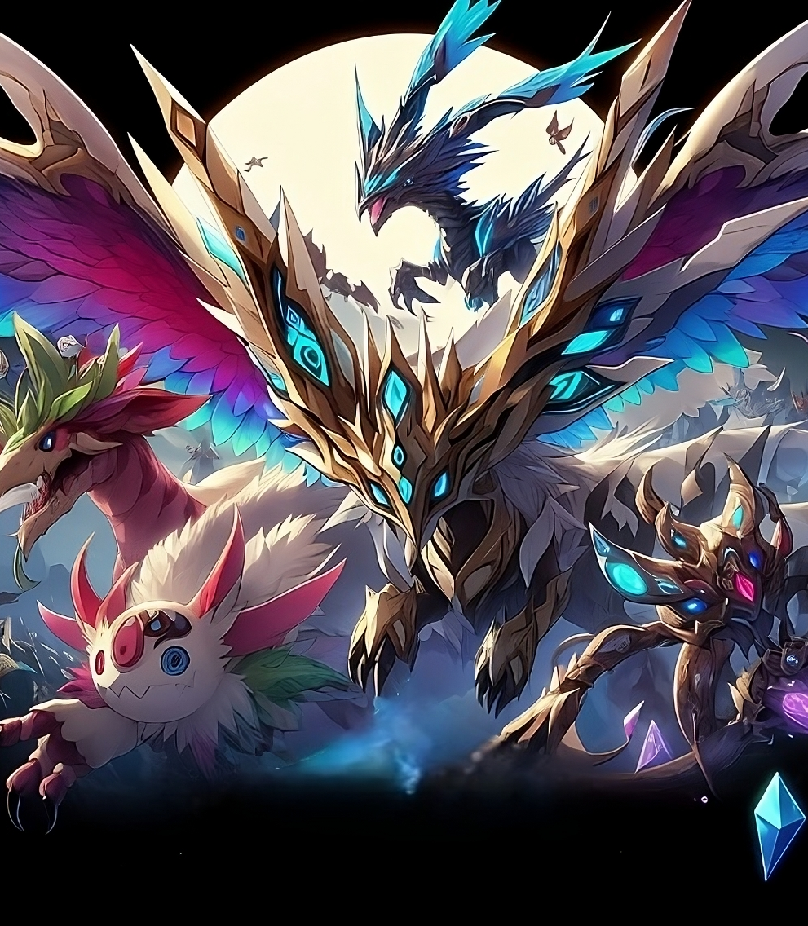


BDLTs project
Group: CryptoFolks
Prof: Claudio Di Ciccio

Slide 2

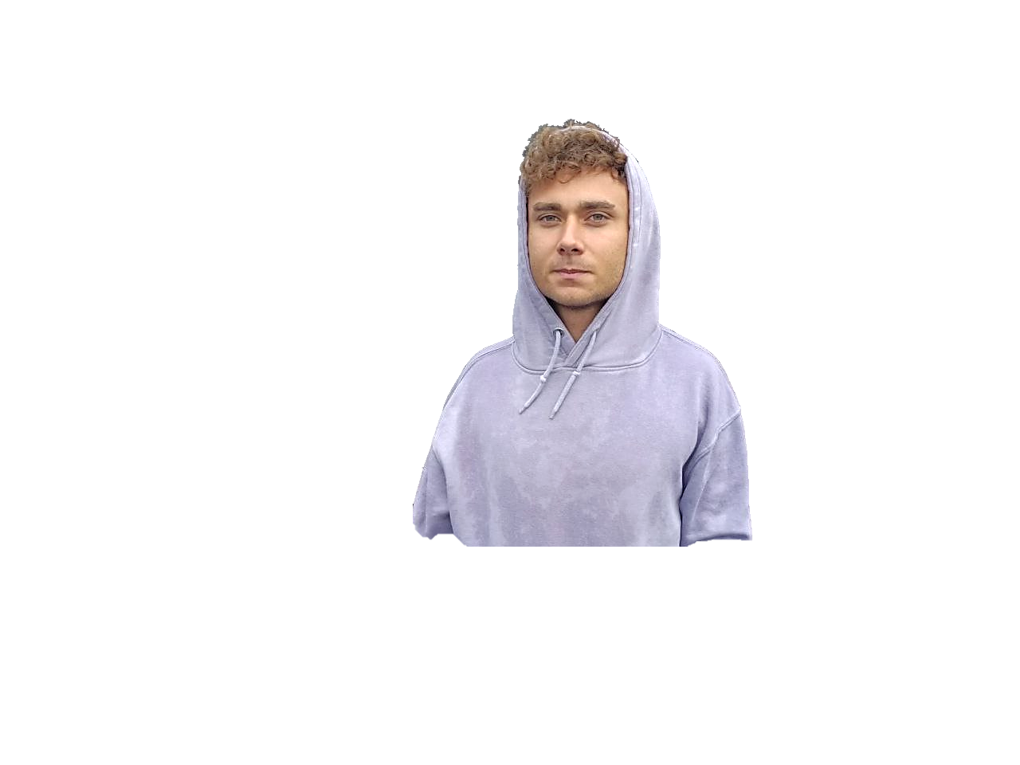

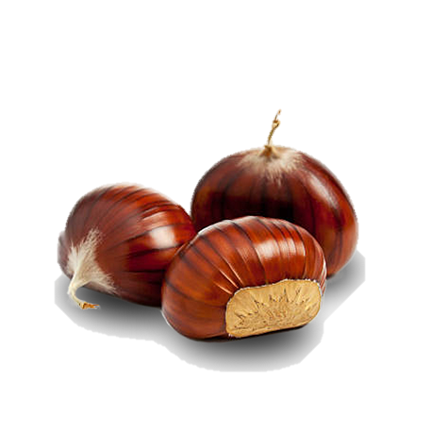
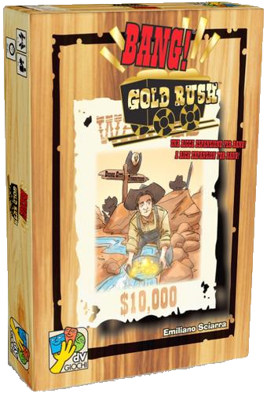
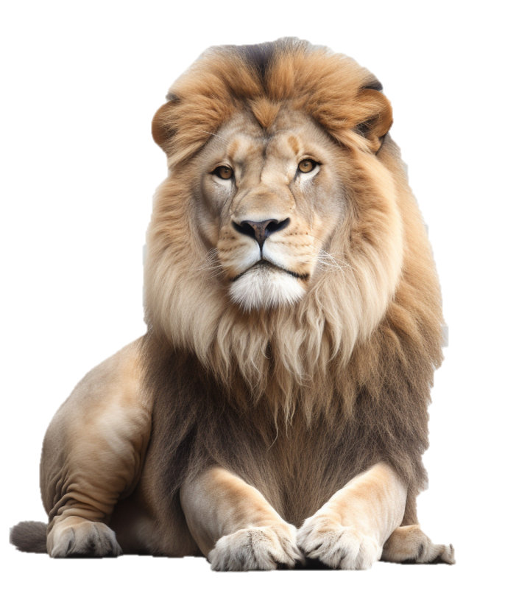



Team
Inventory
Nicolò Dentale
Abilities
1868948
Artwork and creativity.
The lion survivor, from Ladispoli.
Creativity
Back-end
AI

Slide 3
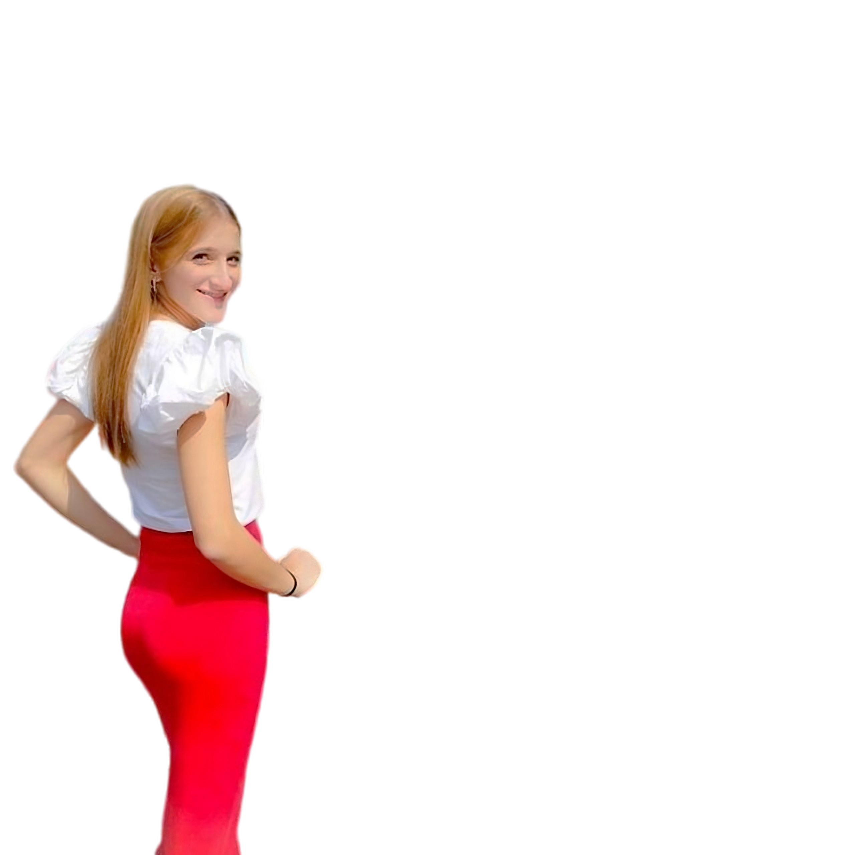

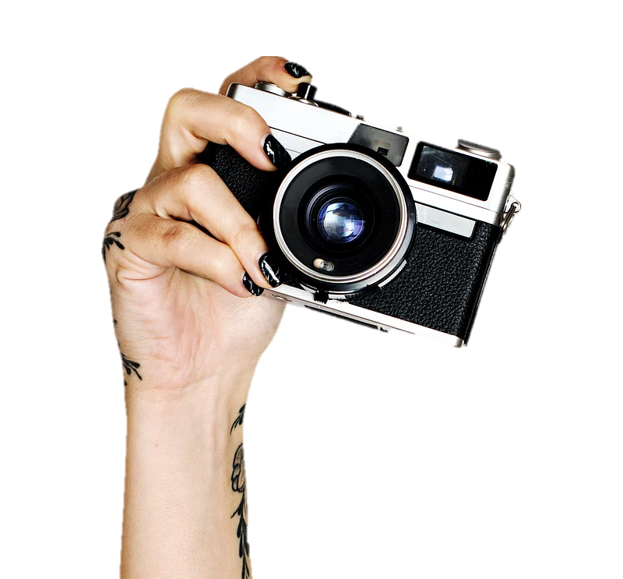





Team
Inventory
Carmelina De Lauso
Abilities
2071848
Study is my passion,
however, sleep is better
Front-end
Design
UML

Slide 4
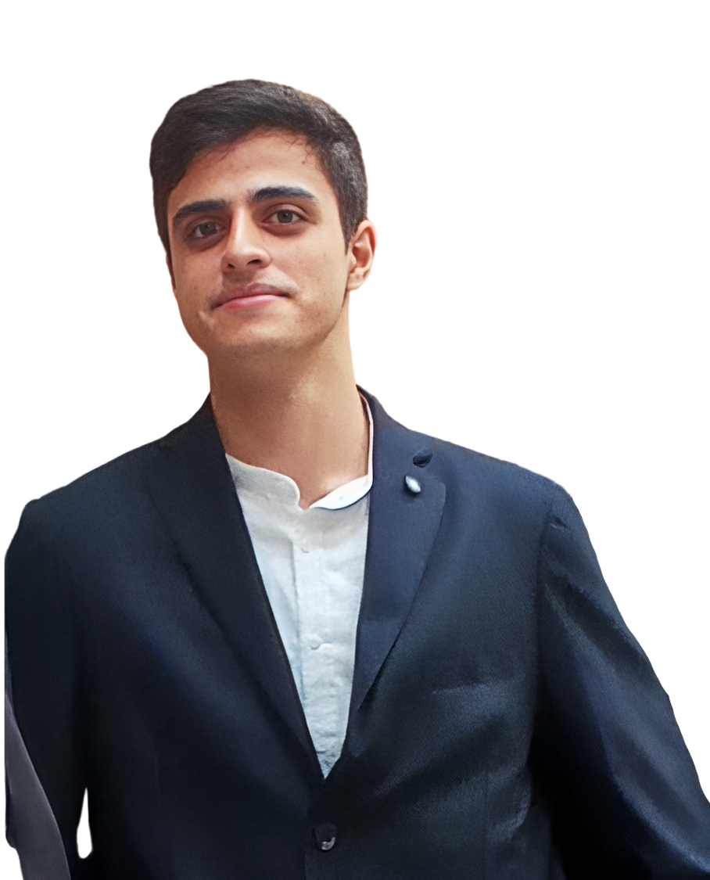

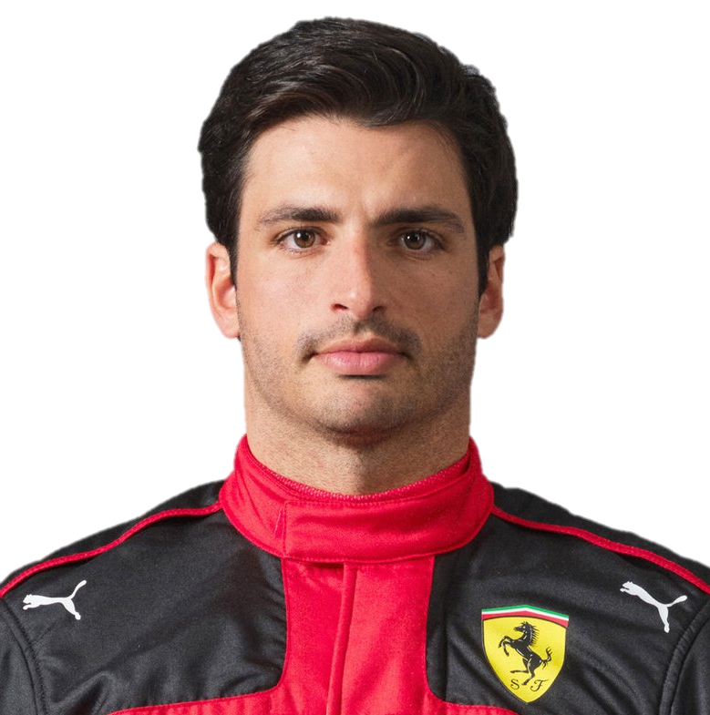

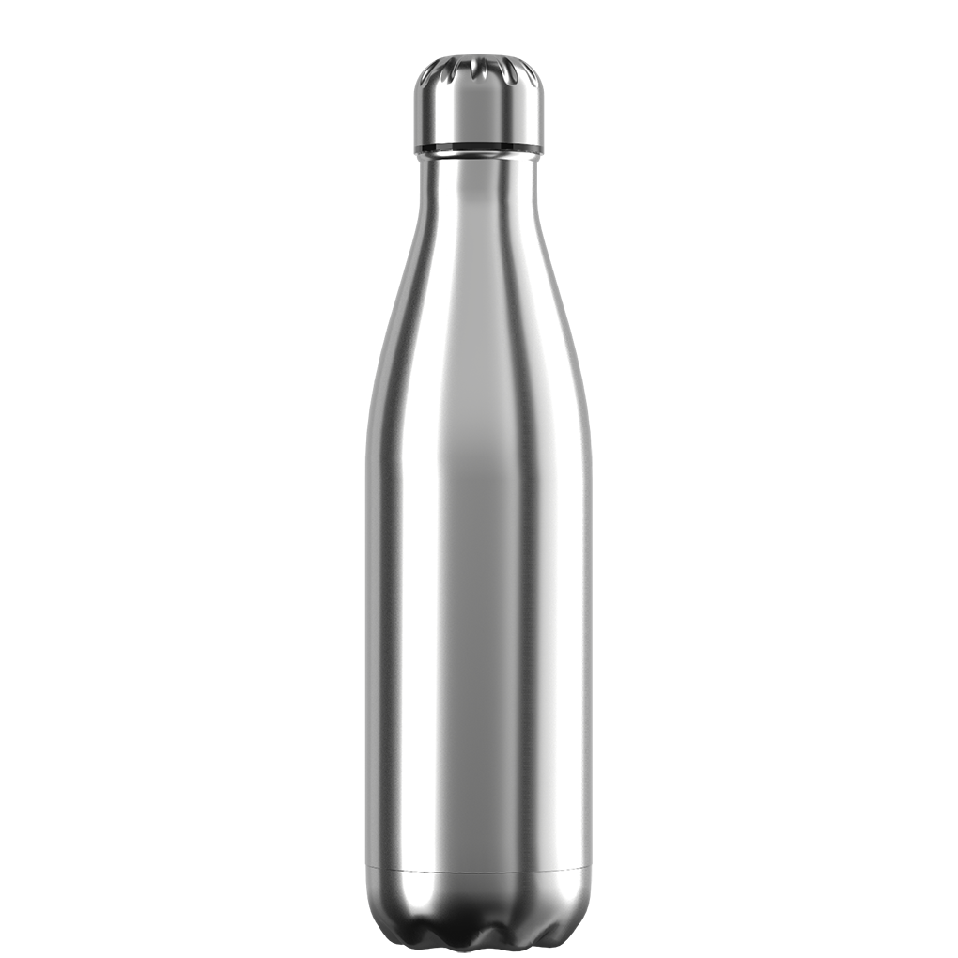


Team
Inventory
Mattia Russo
Abilities
1918968
The mind and the arm,
smooth operator
Back-end
Solidity
UML

Slide 5
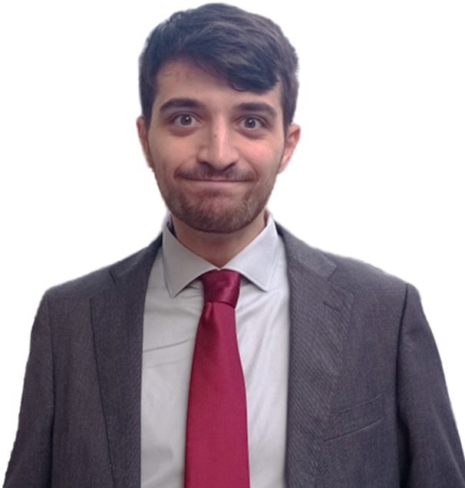
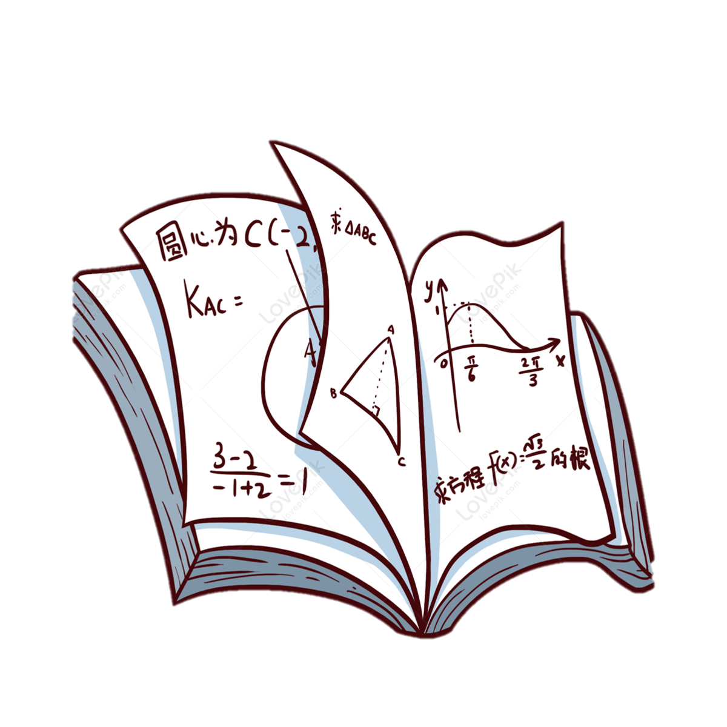


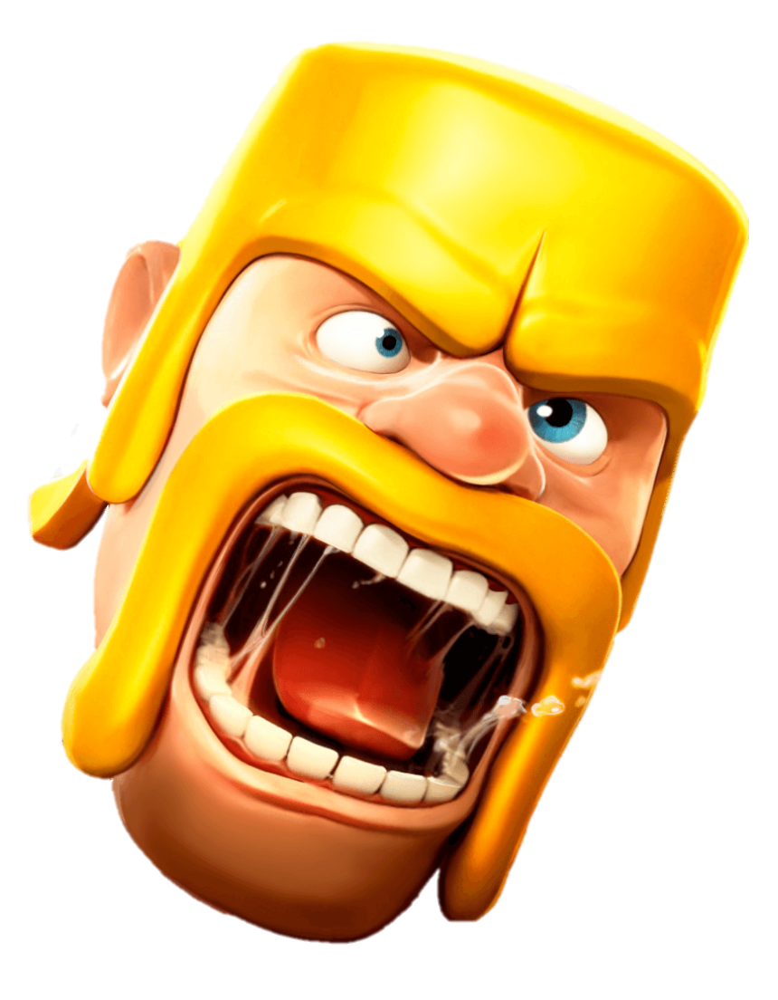
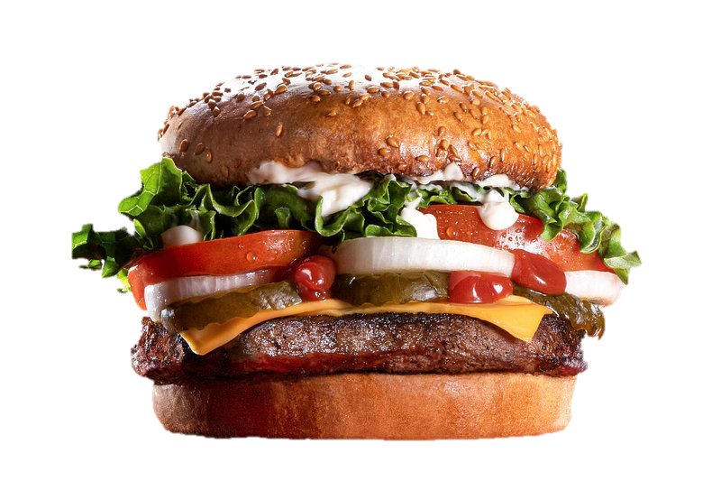

Team
Inventory
Claudio Schiavella
Abilities
1884561
Commitment, passion, stakanovism and lots of anxiety.
PowerPoint
Solidity
AI

Slide 6
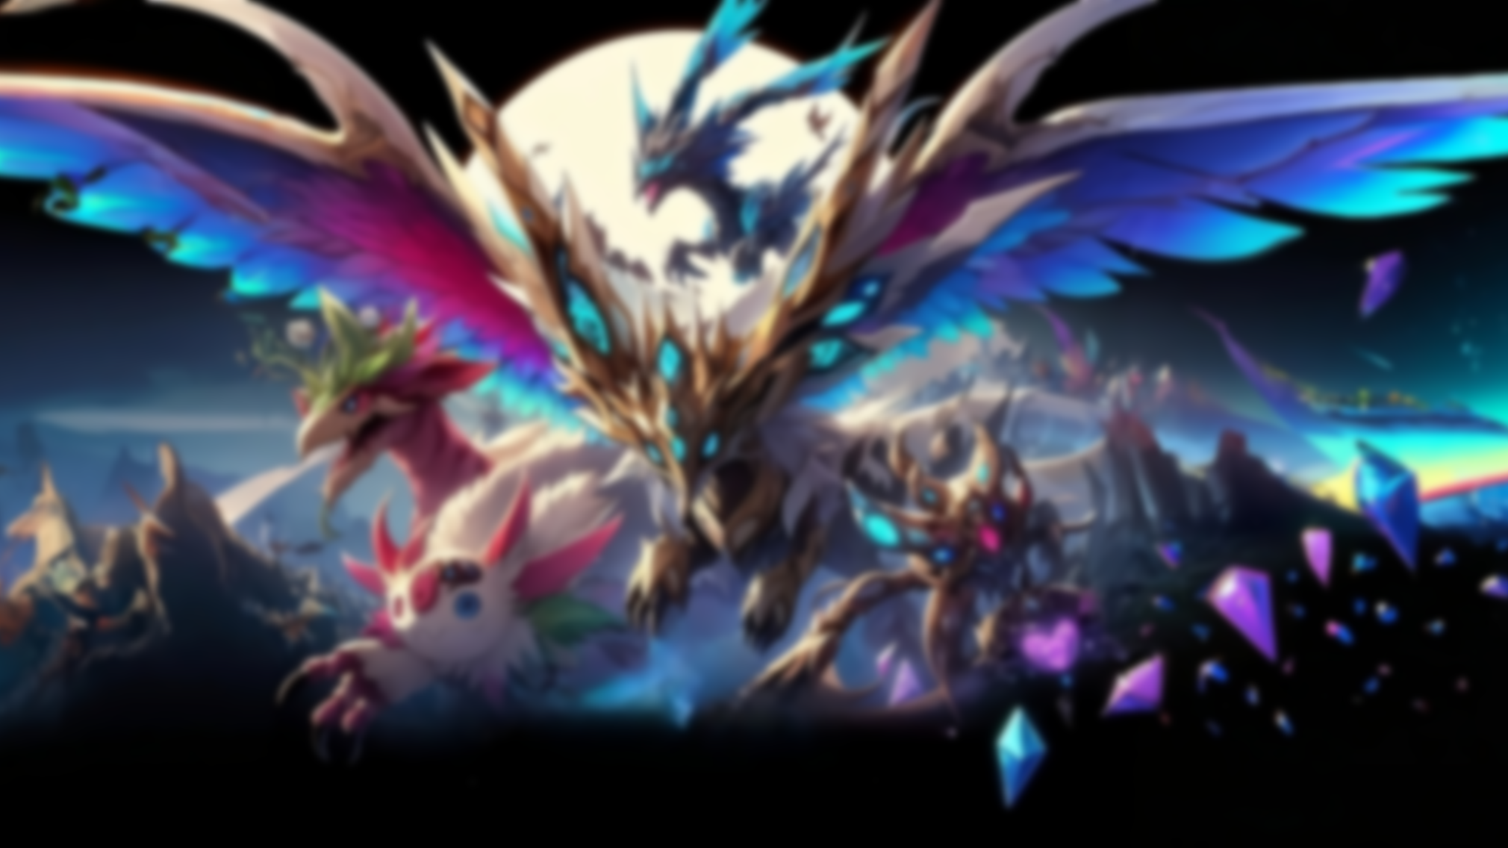
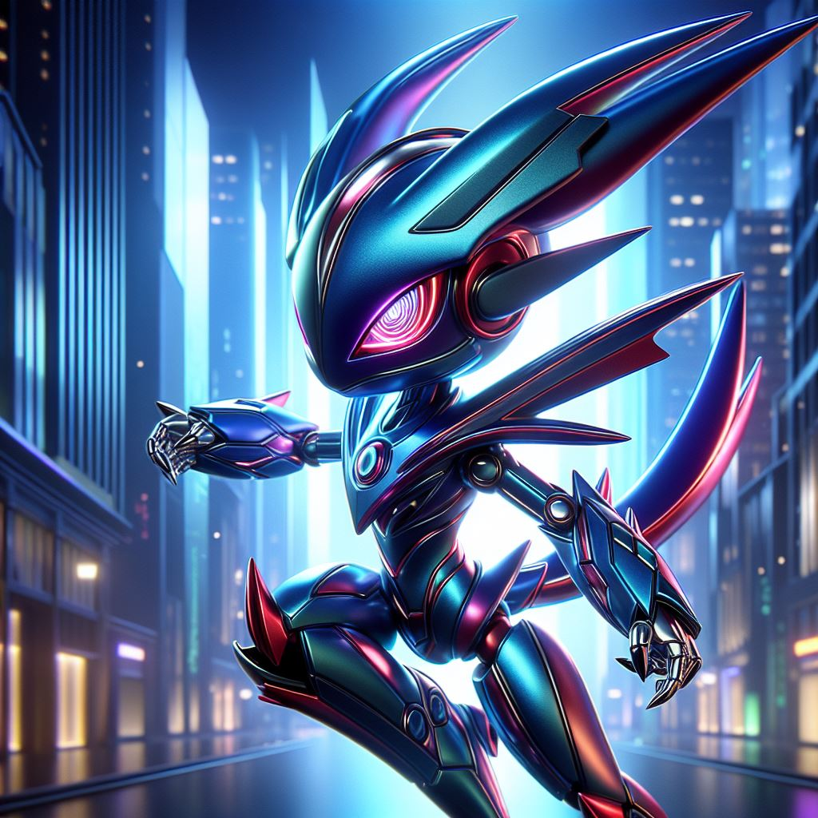
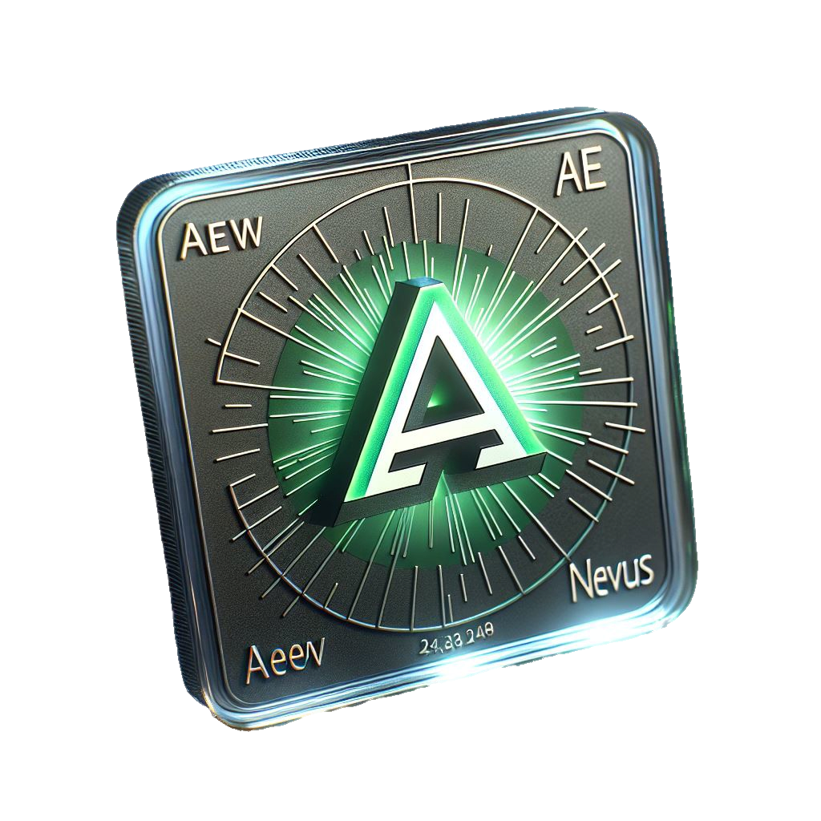
Goal: Making a game of AI-generated collectibles
Trading and tasks
Market with fungible token

Slide 7
Goal: Making a game of AI-generated collectibles
YES
Store state
?
It is necessary to know the owner of each collectible and avoid duplication
Trading and tasks
Market with fungible token
Multiple
writers
?

Slide 8
Store state
?
YES
Multiple
writers
?
It is necessary to know the owner of each collectible and avoid duplication
Use TTP
?

Slide 9
Multiple
writers
?
NO
Use TTP
?
Has anyone ever had a figurine manager?
Known writers?

Slide 10
Use TTP
?
NO
Known writers?
It would be nice to meet everyone who is passionate about our project, but we are shy.

Slide 11
Multiple
writers
?
Website
Known writers?
Store state
?
Permissionless Blockchain
Use TTP
?
Decentralized
Efficiency
No cheating

Slide 12
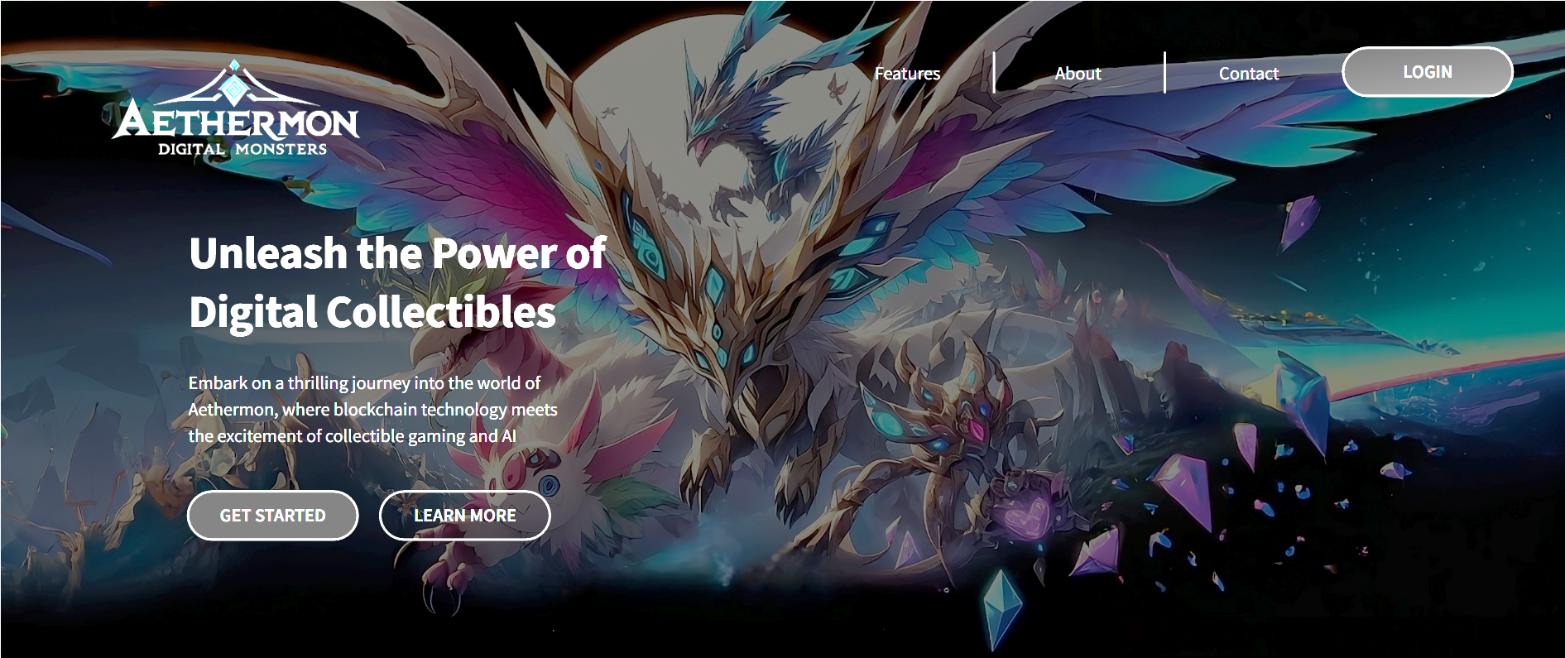
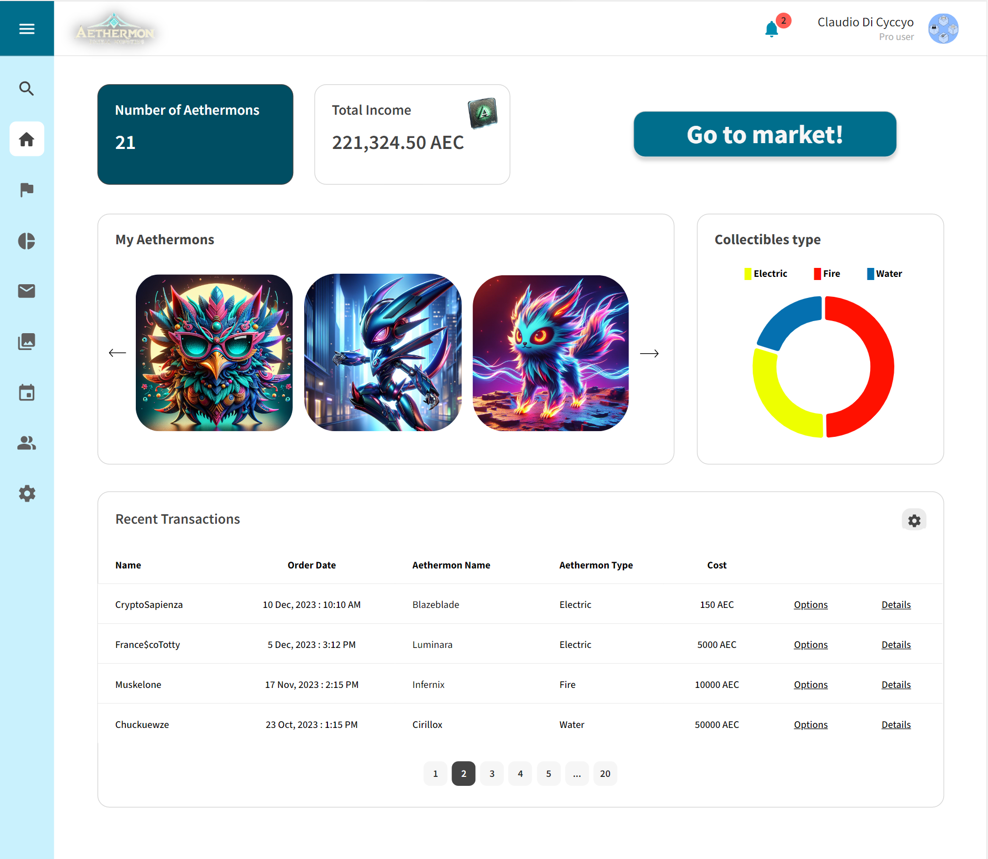
Website
Permissionless Blockchain
Decentralized
Efficiency
No cheating

Slide 13
Website

Slide 14
Website
Possible issues

Slide 15

Website
Possible issues
Put the AI model on chain
Market and tasks complexity

Slide 16
THANK YOU FOR THE ATTENTION!
Gotta catch’em all and
Vote for us!
(we have candies and kitties)

